Slide 1
My System Looks like it Works….but how do I Prove it?
John Horncastle.
Lead Pharmacist – Production & Preparation.
Newcastle Hospitals NHS Foundation Trust

Slide 2
Overview
Introduction
Why do we need to validate systems?
Defining a computerised system
The validation process

Slide 3
Introduction
Who I am and Why I’m talking to you
Production Pharmacist at Newcastle RVI
Led on computerised system validation in RVI unit
Written current guidance for computerised system validation in NHS aseptic units
NHS England approached us for guidance (via National QA Committee)

Slide 4
Introduction
Increasing use of computers for all aspects of patient care.
Massive benefits when it works
Massive potential for patient harm if it doesn’t!
Increasing complexity leads to greater chance of unforeseen problems.
Detailed testing should manage risks before they cause harm

Slide 5
When it goes wrong
System Set up with Option of ordering in “mg” or “mg/kg” to allow flexibility
Doctor original order in mg/kg for 38.6kg patient
  “Rx Co-trimoxazole 5mg/kg”
  Dose = 193mg
Closest tablet = 160mg – Pharmacy ask Dr to alter prescription to “160mg”

Slide 6
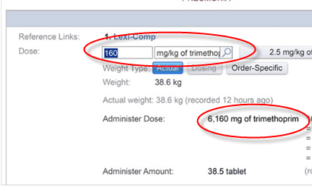
Doctor opens original order and types “160”
Forgets to change dosing mode to “mg”

Slide 7
No warning of which prescribing mode was selected
No hard-stops or dose checking put in place
Massive overdose
Could this have been foreseen and prevented?
  Different system design
  User training
  https://medium.com/backchannel/how-technology-led-a-hospital-to-give-a-patient-38-times-his-dosage-ded7b3688558

Slide 8
A computerised system (E.g. E-Prescribing)
Software which manages prescribing.
PC hardware running the software
Printers connected to that PC
Network connecting the system to the wider hospital infrastructure.
People using the system
SOPs on how to use the system
Process being performed with / by the system

Slide 9
Considerations
Where a computerised system replaces a manual operation, there should be no resultant decrease in;
Product quality
Process control
Quality assurance.
There should be no increase in the overall risk of the process.

Slide 10
Validation
A standardised approach to validating all computerised systems should be used and documented in a Computerised systems Validation master plan (csVMP).
The level of resource put into validating a system should be commensurate with the risk posed by system failure
    - Calculating Drug Interaction
    - Printing ward box delivery labels

Slide 11
Walking the Validation Path (New System)
1) Define your requirements
(User Requirement Specification)
  Consider a scoring system.
2) Assess available solutions
  (Design Qualification)
3) Consider assessing supplier
Supplier Audit, Reputation, Previous NHS?
4) Choose!

Slide 12
Scoring Systems
“MoSCoW” – Which defines requirements as;
  Must Have (Essential Function)
  Should have (High Priority but not essential)
  Could have (Desirable but not necessary)
  Would Like (Would like to see functionality offered in the future)
Assessment of each feature of a system as
  Essential
  Desirable
  Indifferent

Slide 13
The Path continues….
5) Install the system – does it work when I switch it on?
(Installation Qualification)
6) Prove that it works IN YOUR UNIT
(Operational Qualification)
The BIG part of the process

Slide 14
A word on “Off the shelf Validation”
Beware manufacturers “Validation Packages”
They prove that the system worked
    In the manufacturers office
    On their system
    With their particular setup and configuration
But will it work like that in YOUR installation?

Slide 15
Focus on OQ
Risk Based Approach
Identify potential Failure modes and score each of these.
Write test cases to deliberately try to cause a failure
Know the expected outcome (ideally the “fail” shouldn’t be allowed to occur)
Test in Triplicate
100% Pass rate expected

Slide 16
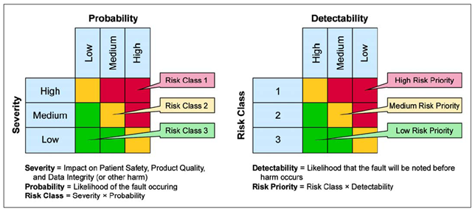
Assessing Risk

Slide 17
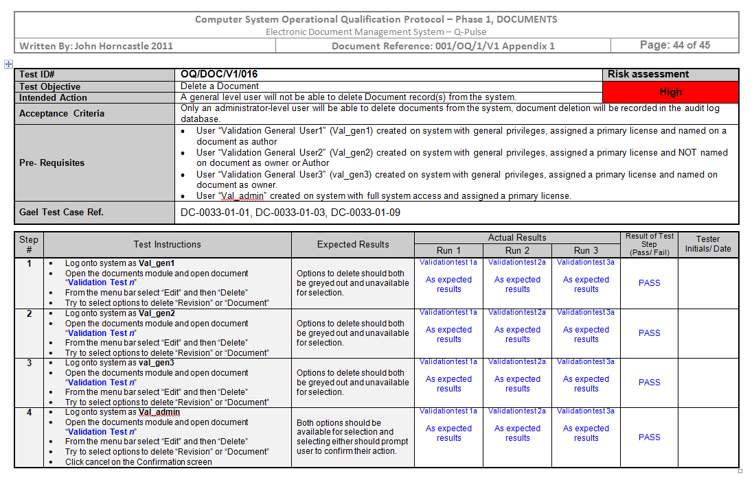
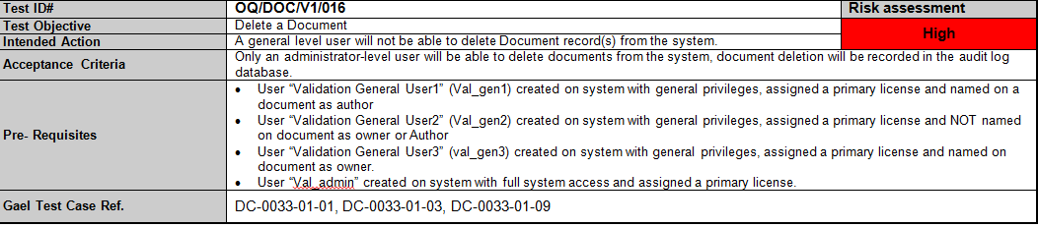
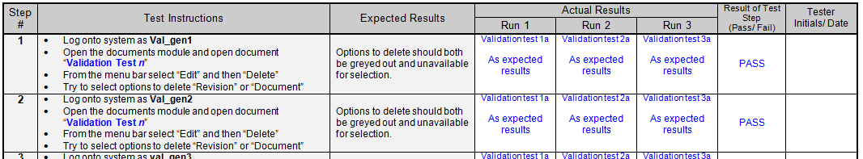
Example OQ Script

Slide 18
Final steps on the journey
Testing the system “In use in real life”
  (Performance Qualification) – Consider;
  Security – access only things they need
  Load Testing – If all staff log on what happens?
  Data Integrity – Changes, Permanence, Audit trails (Also links to security)
Train the users – and assess competence! (Don’t leave the training to the System Expert)

Slide 19
The end of the journey…..or is it?
Maintaining validated state
Change control
  Updates / Upgrades
  Configuration changes (E.g. New ingredients added)
Performance Requalification
  Periodic retest using OQ / PQ scripts

Slide 20
Hope for the best…..Plan for the worst
Disaster Recovery plan
Modern systems & networks WILL break (Despite what IT tell you!) Aim for;
    A method of running the system from backup data which mirrors “normal” functionality.
    An approved written procedure of how to bring the backup system into use.
    Documentary evidence that this plan has been tested as effective.

Slide 21
Document everything
User requirement specification
Risk assessment
System validation Report to include;
  Detail of IQ test results
  OQ protocol (Comprising a full set of completed test cases)
  Traceability matrix (Tying together risk assessment outcomes with OQ test cases)
  PQ Protocol (With results of “In-Use” testing performed)

Slide 22
Documents continued…
A system description detailing;
  Principles, objectives, and scope of the computerised system
  System topology (Listing PC’s, and associated servers, networks etc).
  Security measures (Including full listing of current user permissions)
  Interfaces to other systems
Record of change control requests relating to the system.
Training records

Slide 23

Thank you!.....
Any Questions?

